Slide 1
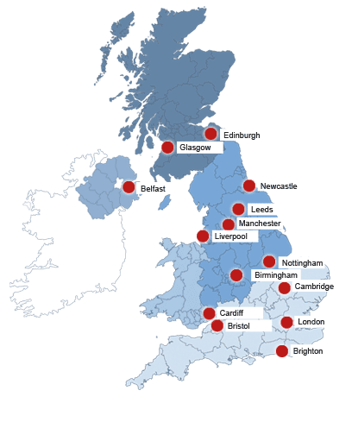
Cities of the UK

Slide 2
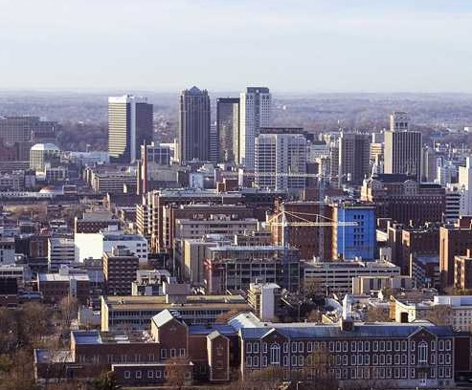
Birmingham
It is one of the most populated city in Great Britain. There are over 1 million people.

Slide 3
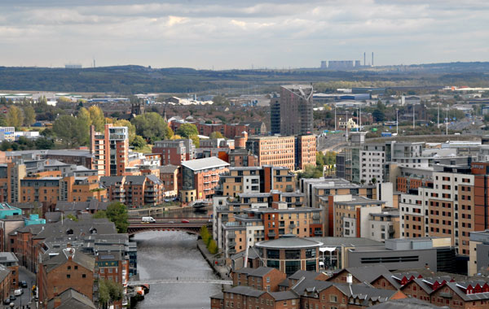
Leeds
Cultural, financial and commercial center of West Yorkshire.

Slide 4
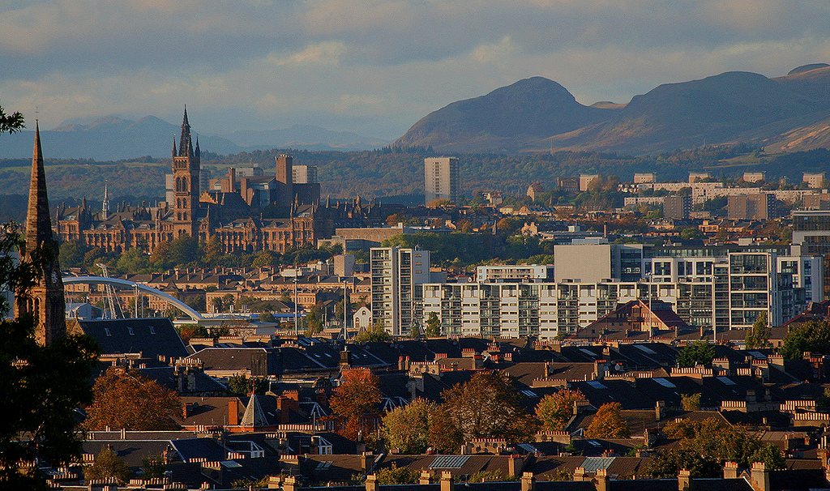
Glasgow
Scotland's largest city. Financial and cultural center.

Slide 5
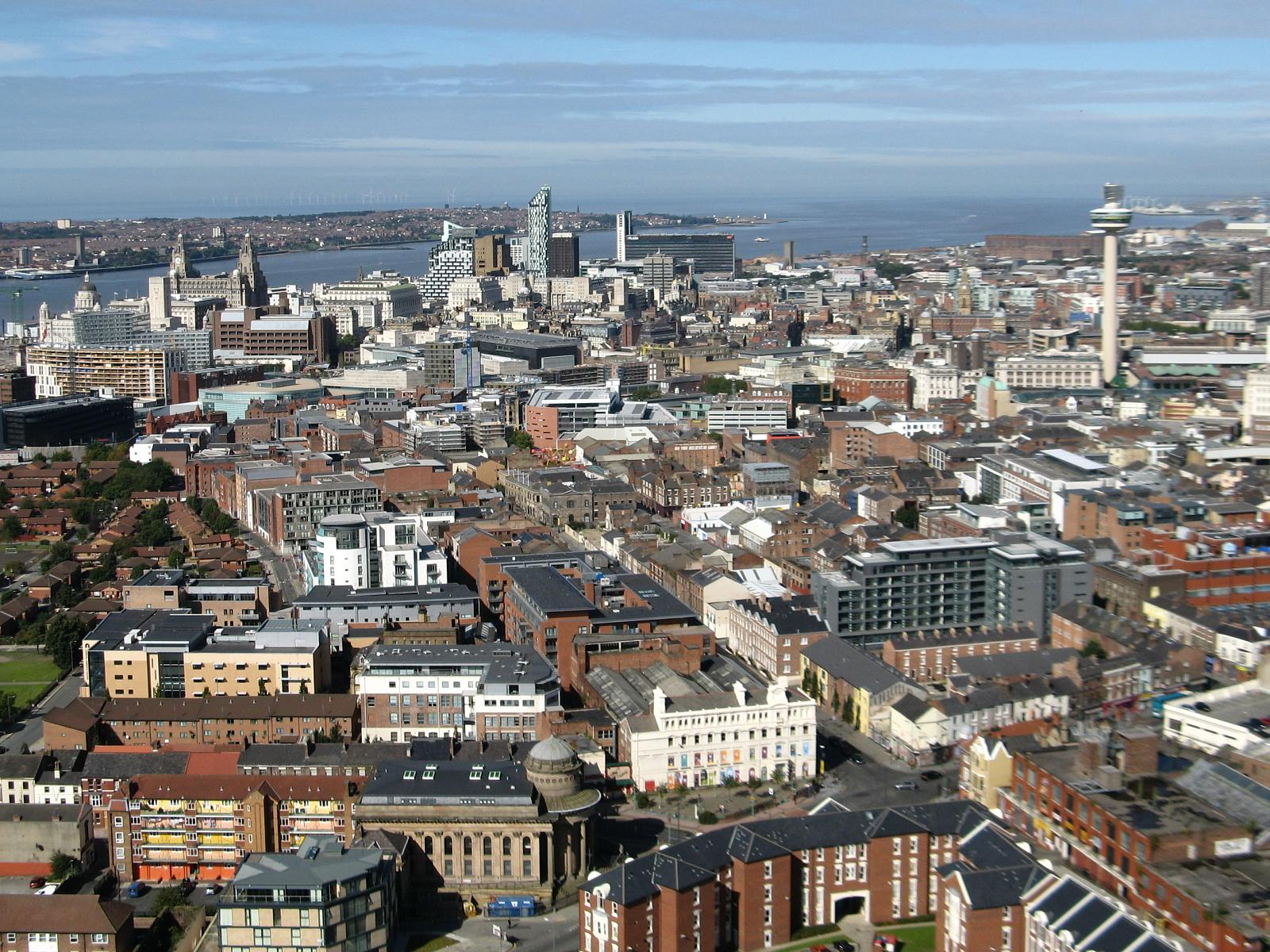
Liverpool
The second largest port in Great Britain.
The Beatles team came from Liverpool.

Slide 6
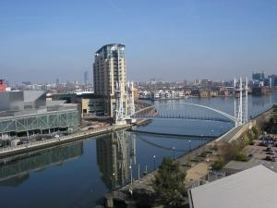
Manchester
This is an important financial, commercial and cultural city of the UK. Famous for its two football clubs; Manchester United and Manchester City.

Slide 7
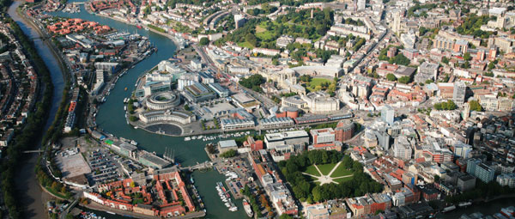
Bristol
The ninth largest city in the UK. It is known from its numerous sites, it is also a powerful cultural and scientific center.

Slide 8
London
London is both the capital of England and the United Kingdom.
It is the largest city of the United Kingdom and the third largest city in Europe.
It has a population of more than 8 million people
This is a place where the government, parliament and queen’s residence is located.

Slide 9
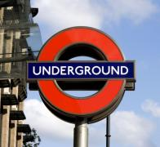
London Underground / the Tube
London Underground is the oldest underground in the world, the first station was opened in 1863.
Despite the English name, indicating the underground location, only about 45% of the length of the route is underground.
About three million passengers travels it everyday.

Slide 10
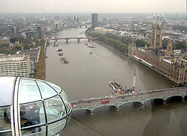
.
London is located on the River Thames, one of the longest rivers of Great Britain,
London is the most popular tourist city in the world.

Slide 11
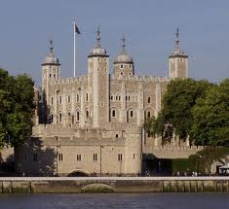
Tower of London
The Tower of London is a defensive building and the palace of rulers of England.
In the past it was also a prison, fortress, and even a zoo.
Now, it is a museum where the crown jewels are held.

Slide 12
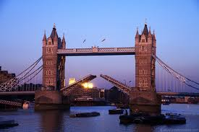
Tower Bridge
It is the only drawbridge on the river Thames.
It was put into service in 1894.

Slide 13
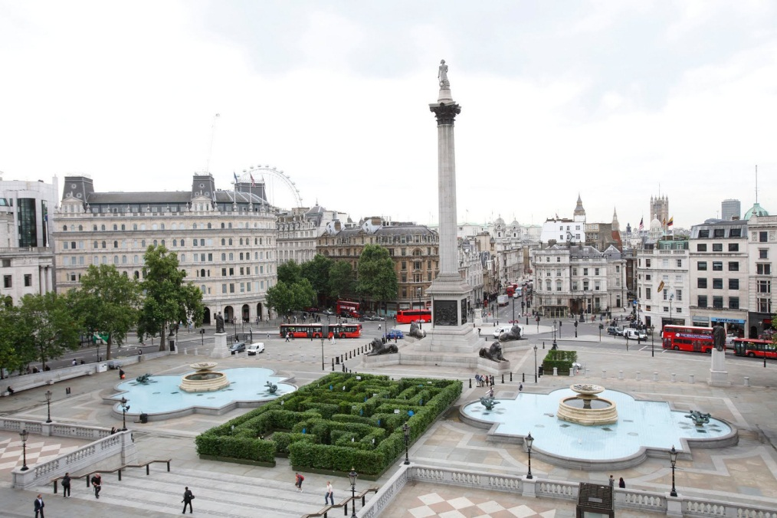
Trafalgar Square
Tralgar Square is a square located in central London.
There is over 51 meters high Nelson's Column - the most famous admiral of the British fleet.
Trafalgar Square is a traditional place for meetings and gatherings, both political and New Year's Eve.

Slide 14
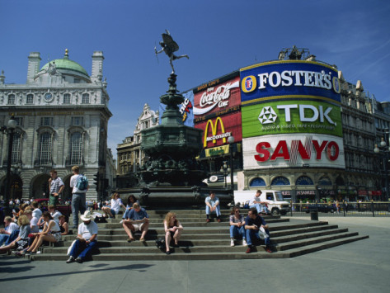
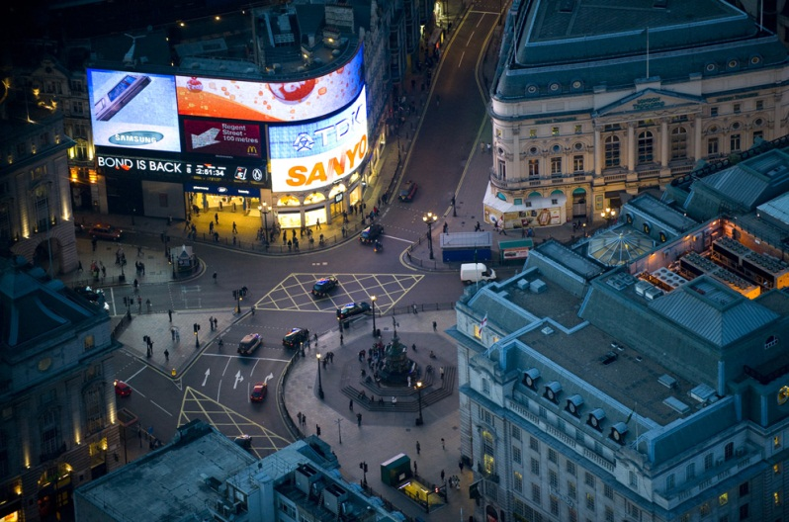
Piccadiily Circus
It is both a square and a crossing of the main streets in the heart of London's West End (theater district).
There is a fountain.
It is a meeting place for Londoners and popular tourist attraction.

Slide 15
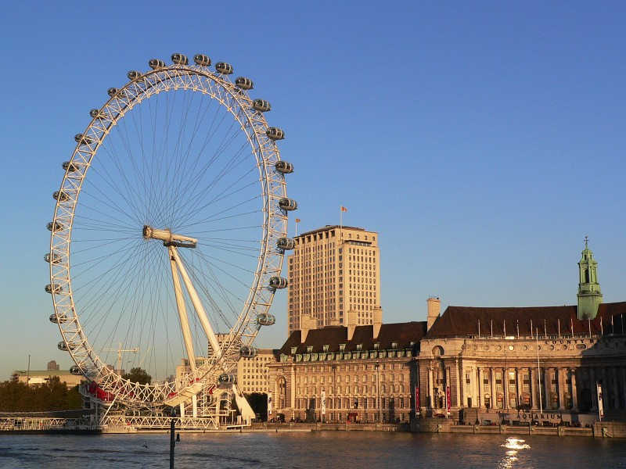
The London Eye (Millennium Wheel)
This is one of the largest observation wheel in the world.
The wheel is 135 meters high, and its full rotation takes about 40 minutes.
There are 32 air-conditioned passenger capsules.

Slide 16
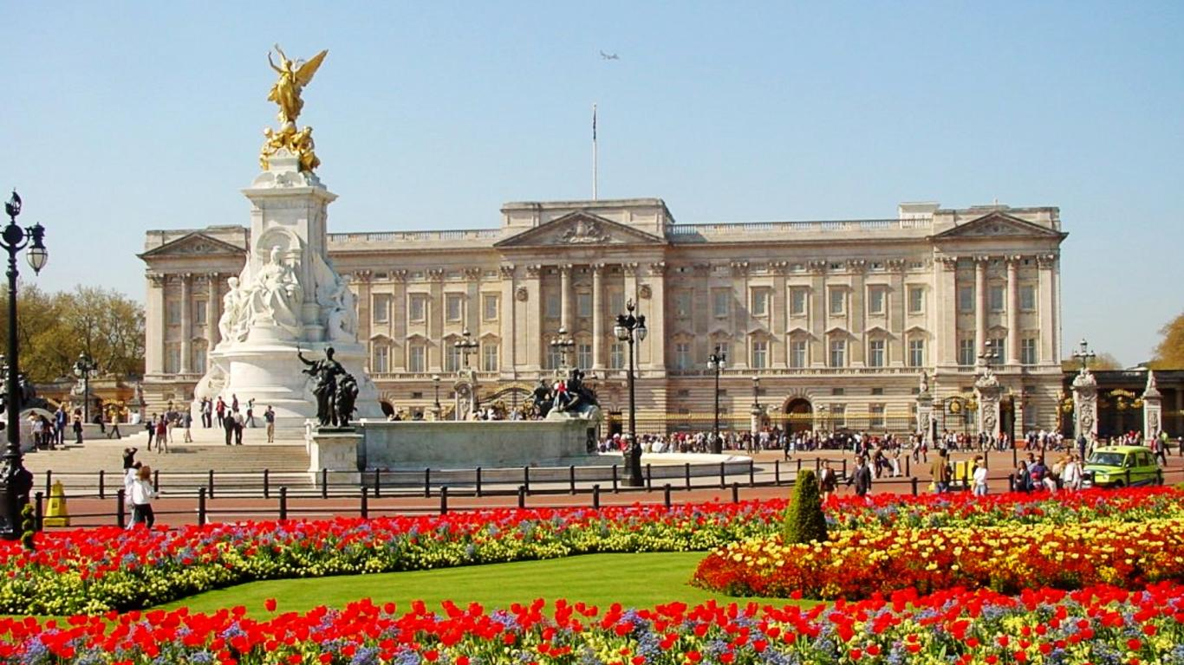
Buckingham Palace
The official London residence of the Queen and the place of state ceremonies and official meetings of heads of state.
From April to July, daily at 11.30 there is a palace ceremonial changing of the guard (in other months every second day). Tourists can visit Buckingham Palace during the queen’s holidays in August and September.

Slide 17
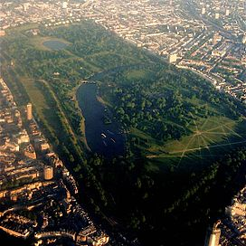
Hyde Park
Royal Park in London. A meeting place for cultural and social events.
There is the so-called. Speakers' Corner, a place where everyone has the right to express opinions and views freely. This is a traditional place of speeches and debates.

Slide 18
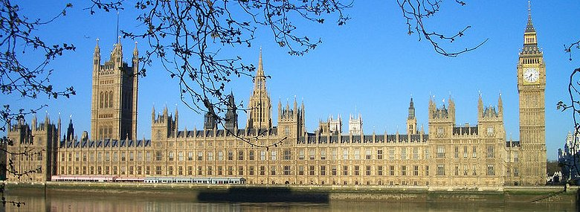
Palace of Westminster - Houses of Parliament
Westminster is a place of meeting of both chambers of Parliament of the United Kingdom (the House of Lords and House of Commons).
One of the most famous part of the palace is the clock tower and a bell called Big Ben.

Slide 19
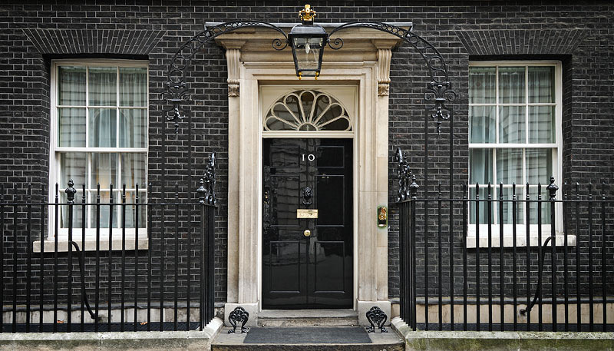
10 Downing Street.
10 Downing Street - the most famous address in London. There is a residence and office of British Prime Minister and Her Majesty's Government.
The building is situated on Downing Street in the City of Westminster near the Palace of Westminster and Buckingham Palace.

Slide 20
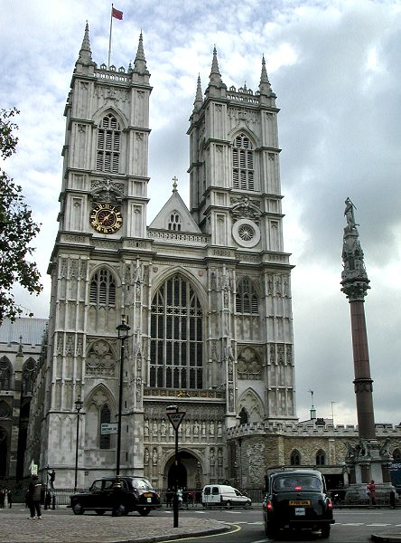
Opactwo Westminsterskie - Westminster Abbey
Westminster Abbey is one of the most important Anglican Church.
Westminster Abbey is the site of the coronation of the kings of England and the UK.
It is also the burial place of kings and people of merit (eg, poets, writers).
Is the place where the royal weddings take place. In 2011 there was a wedding of Prince William and Catherine Middleton.

Slide 21
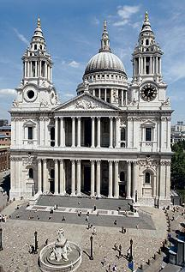
St Paul's Cathedral
This is one of the most famous Anglican churches in the UK.
There was the wedding ceremony of Prince Charles to Lady Diana Spencer.

Slide 22
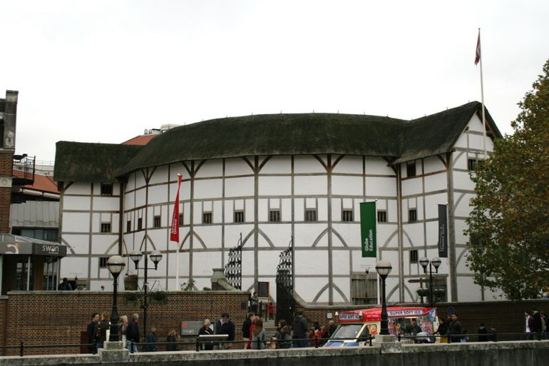
Shakespeare's Globe Theatre
It is the seventeenth - century theater where William Shakespeare staged his plays.

Slide 23
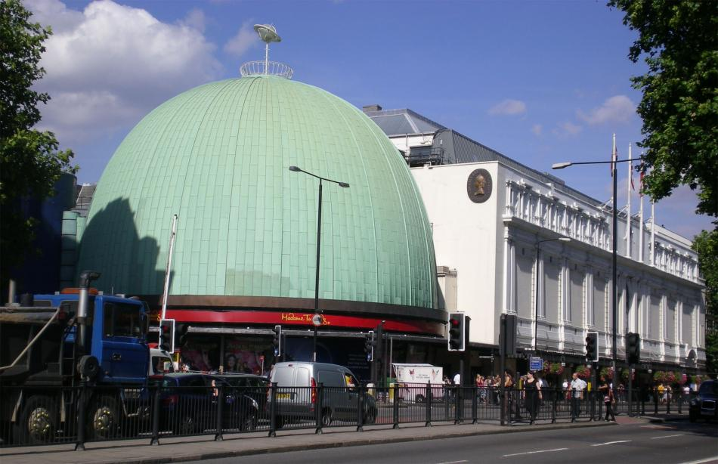
Madame Tussauds Museum
There are a lot of waxworks of famous people, founded in 1835 by Marie Tussaud (1761-1850).

Slide 24
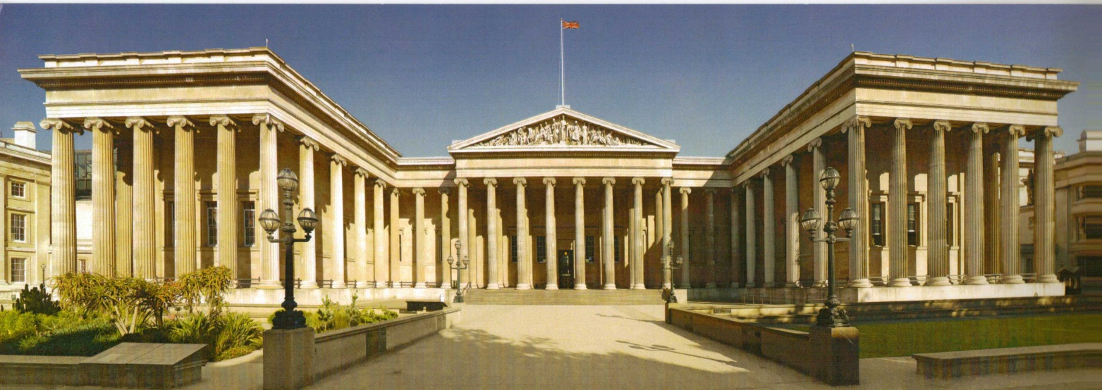
British Museum
One of the largest museums of ancient history.
The tickets are free.

Slide 25
National Gallery
Presents a collection of paintings from the years 1250 to 1900.
There is a collection of 2,300 works of painting, mainly Western European.
The entrance to the gallery is free of charge.

Slide 26
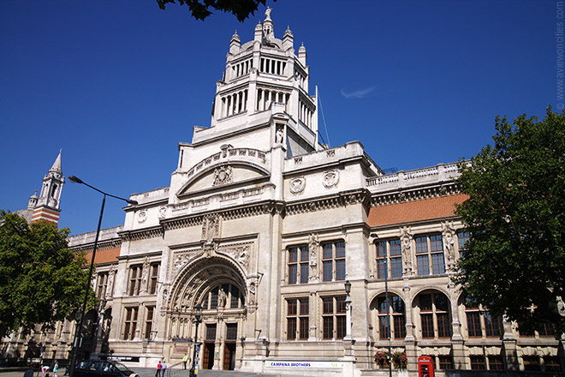
Victoria and Albert Museum
One of the largest museums of decorative arts in the world. The permanent collection consists of over 4.5 million exhibits. The collection includes objects created for over 5000 years from Europe, North America, North Africa and Asia.
There are sculptures, paintings, drawings, photographs, books, ceramics, furniture, textiles, clothing, glassware and metal.

Slide 27
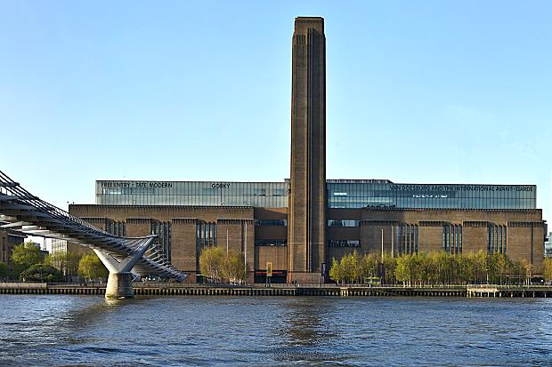
Tate Modern
Tate Modern is the Britain's national museum of international modern art.

Slide 28
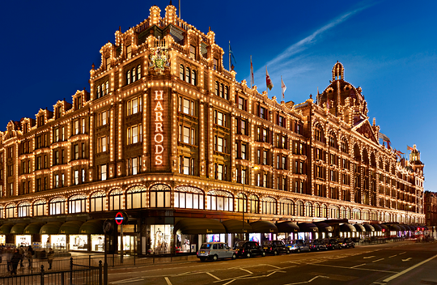
Harrods
Harrods - a luxury department store in the Brompton Road, Knightsbridge

Slide 29
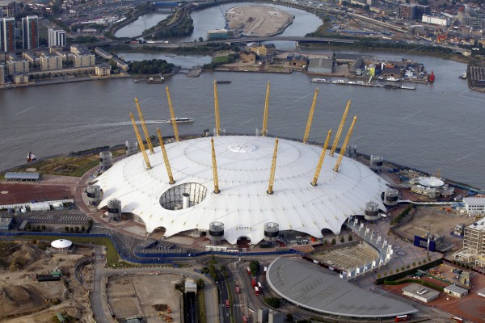
Millennium Dome (O2 Arena)
Millennium Dome (also known as the O2 Arena) - building built in 1999 to celebrate the new millennium.
Millennium Dome is the world's largest roof (diameter - 365m).
Place where big concerts and cultural events take place.

Slide 30
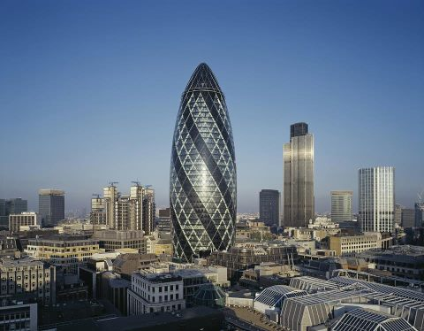
30 St Mary Axe
High-rise building located in the City of London, London's main financial district, also known as the 'Swiss Re' or 'Gherkin'
Tower has 40 floors and it’s 180 meters high.

Slide 31
Shard London Bridge (The Shard)
High-rise building with 72 floors. Its height is 309.6 meters. In 2012 it became the tallest skyscraper in Europe.

